Slide 1
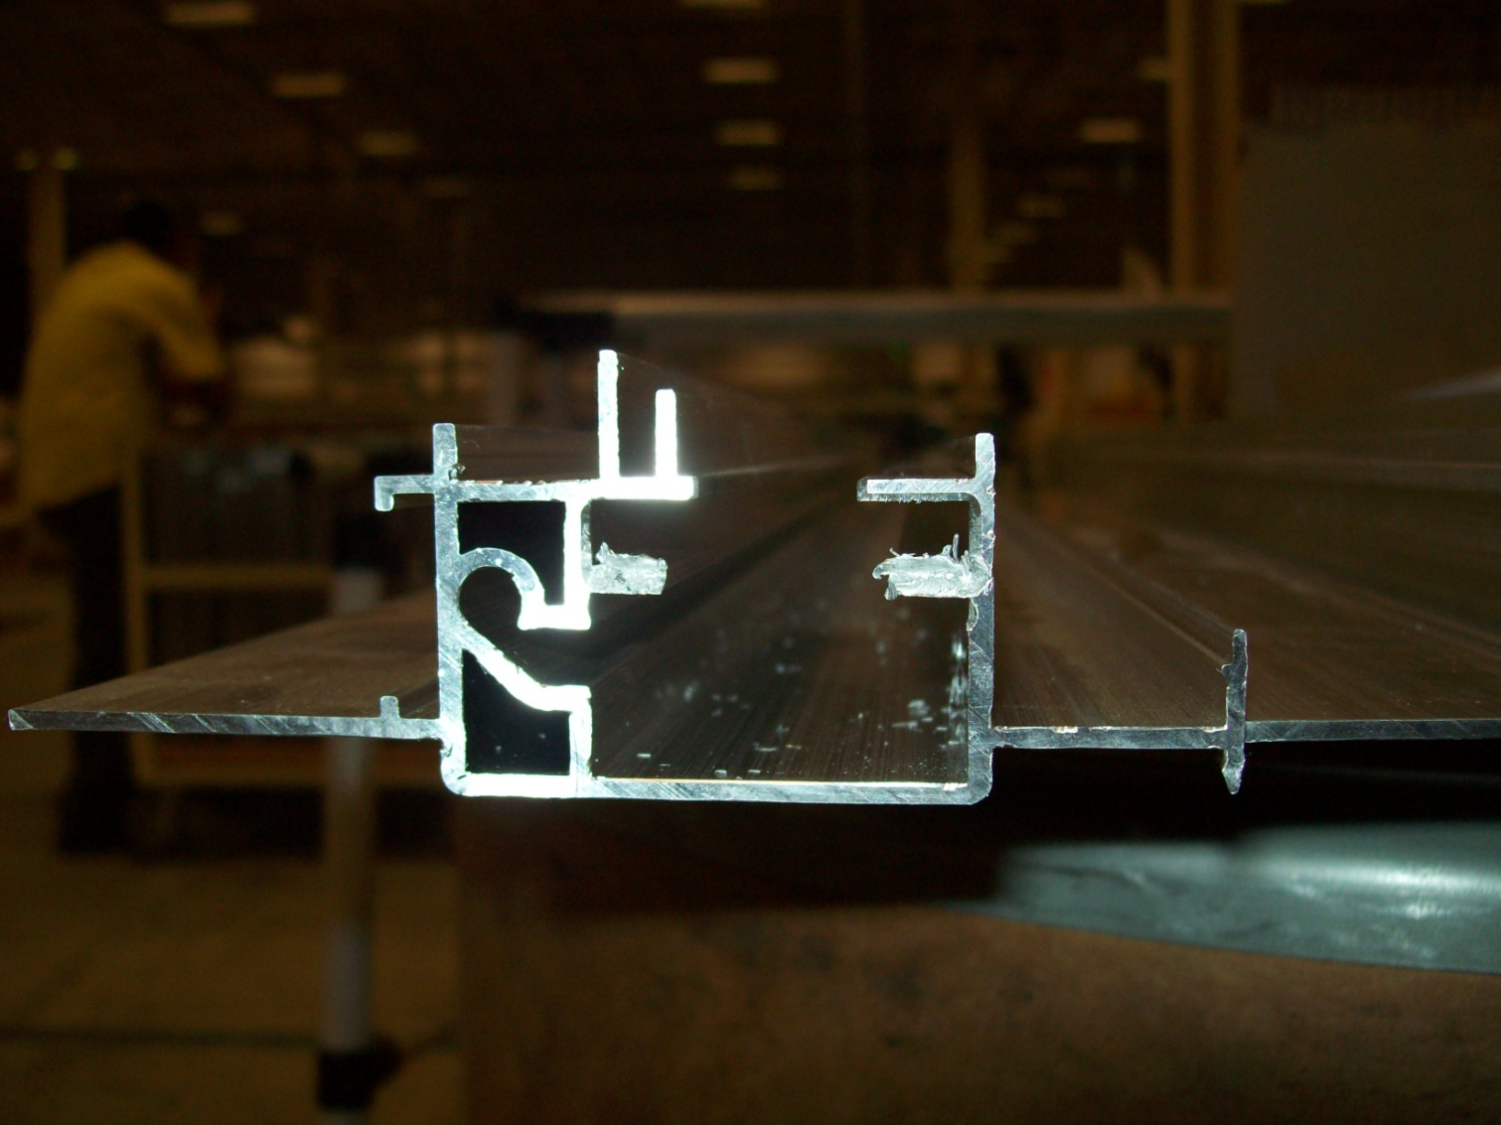

Slide 2
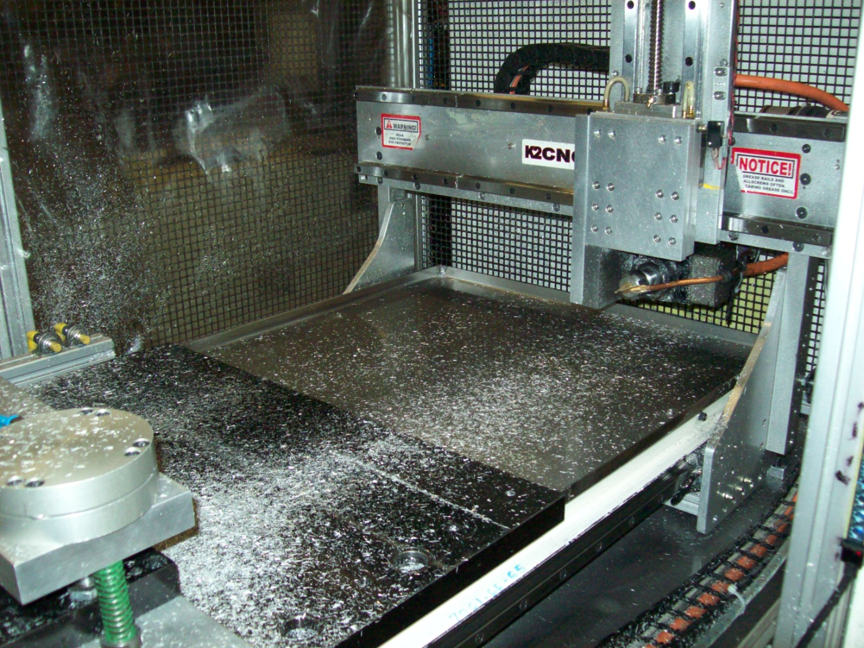
Home servos

Slide 3
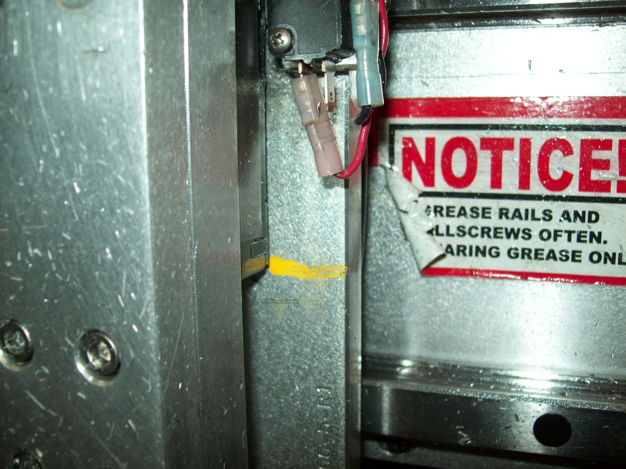
Home zero on Y axis does not repeat

Slide 4
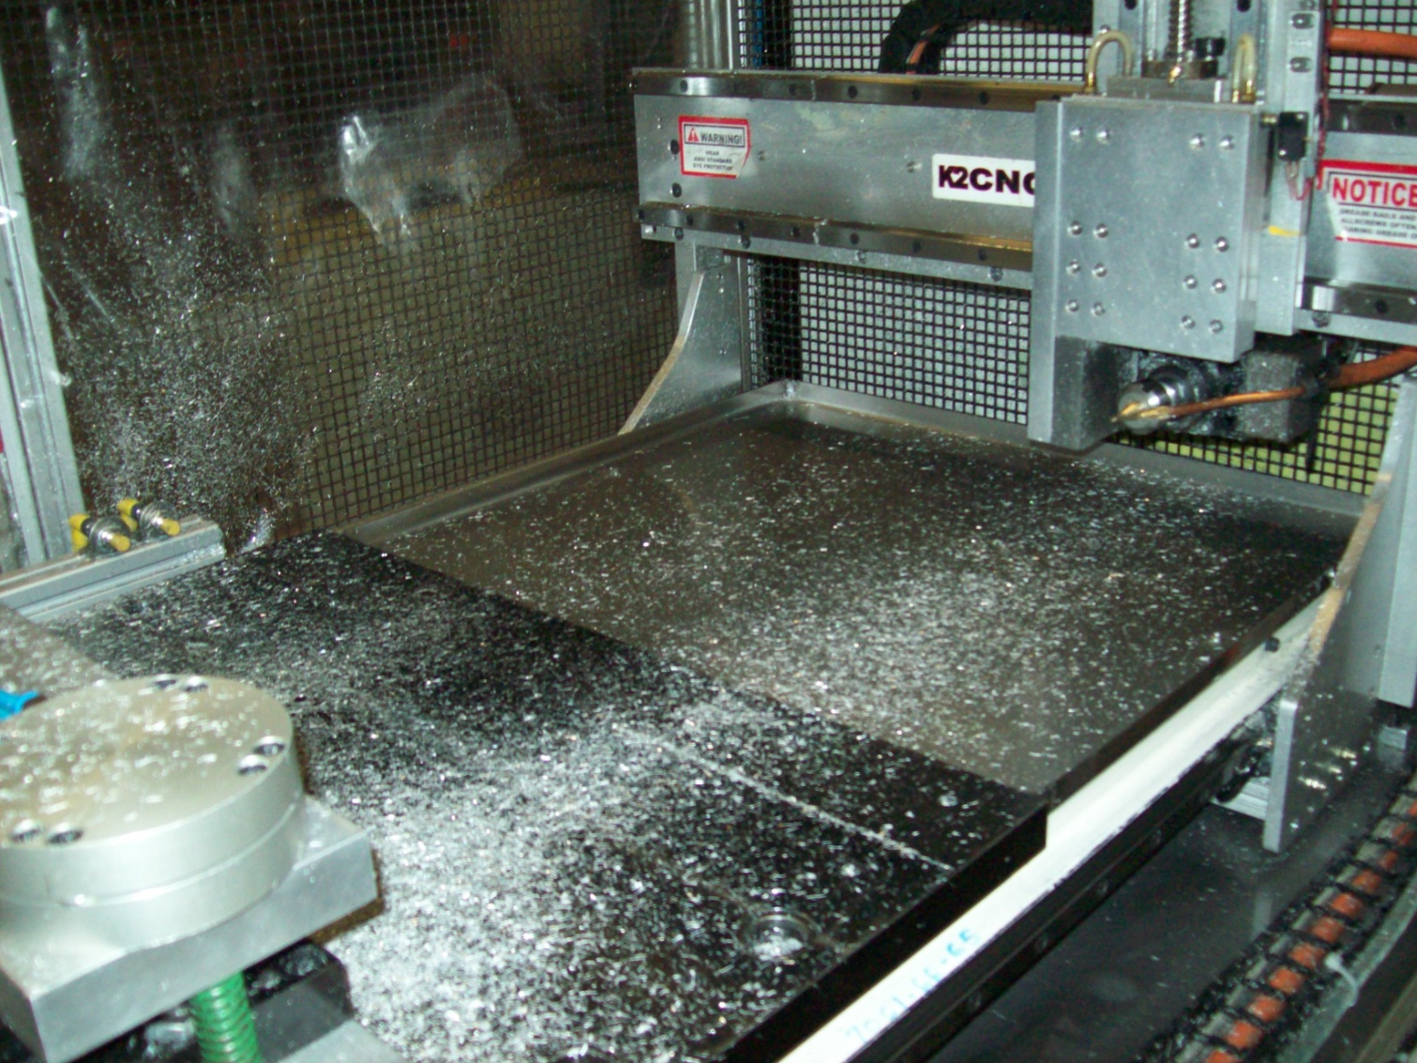
Home servos

Slide 5
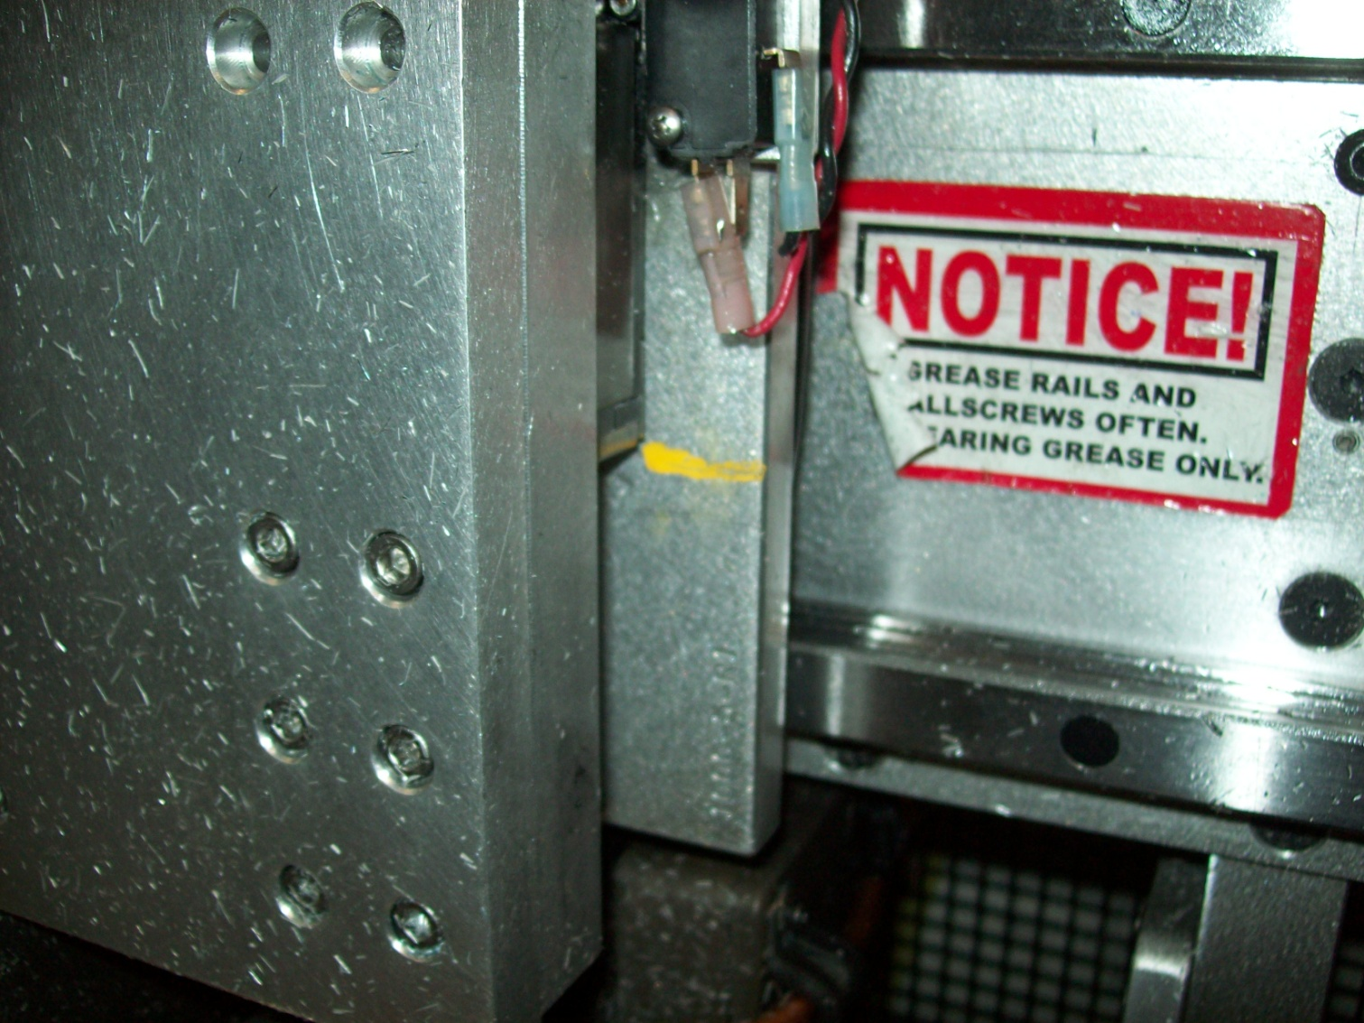
Home zero on Y axis after turn off the machine it repeats

